Slide 1
Variances

Slide 2
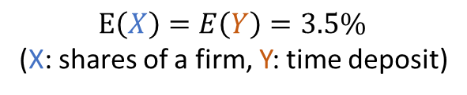
Spread of a distribution
E(X) indicates the average value of X, what we expect to see in the long run – Remember E(X) is a constant, calculated based on X’s distribution
It’s often of great practical interest to measure the tendency that X is spreading out relative to E(X) – That number can tell us something about the shape of the distribution
The two investments have the same expected returns but different spreads
$$E\left(X\right)=E\left(Y\right)=3.5\%$$
(X: shares of a firm, Y: time deposit)
Negative return
High return
0
3.5

Slide 3
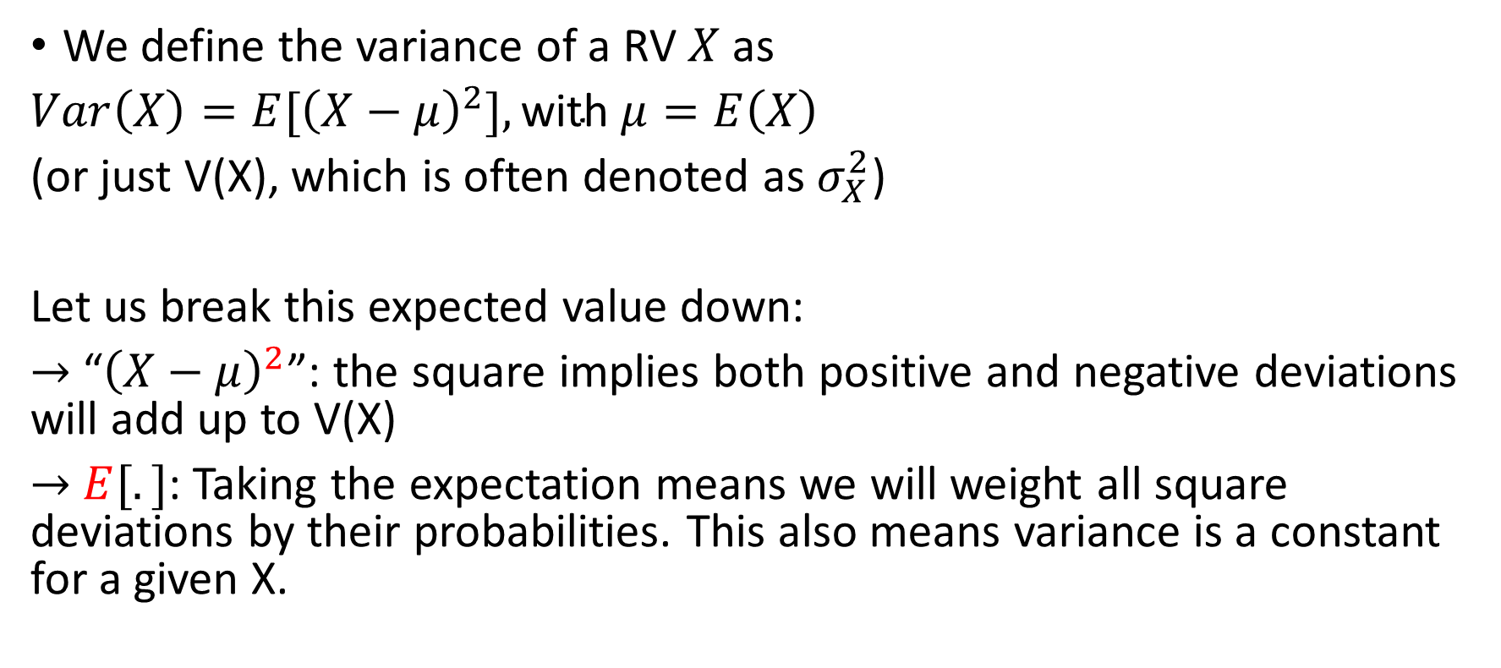
Variance of a random variable
We define the variance of a RV $X$ as
$Var\left(X\right)=E{[\left(X−μ\right)}^{2}],\text{with} μ=E\left(X\right)$
(or just V(X), which is often denoted as $σ_{X}^{2}$)
Let us break this expected value down:
$→$ “${\left(X−μ\right)}^{2}$”: the square implies both positive and negative deviations will add up to V(X)
$→$ $E[.]$: Taking the expectation means we will weight all square deviations by their probabilities. This also means variance is a constant for a given X.

Slide 4
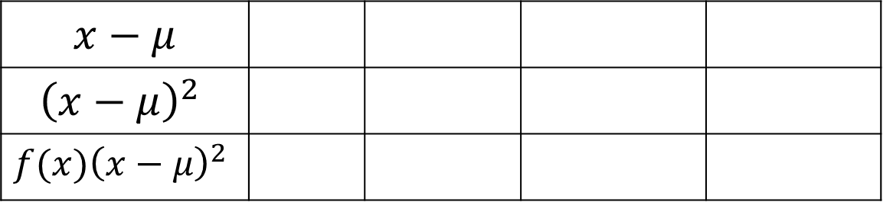
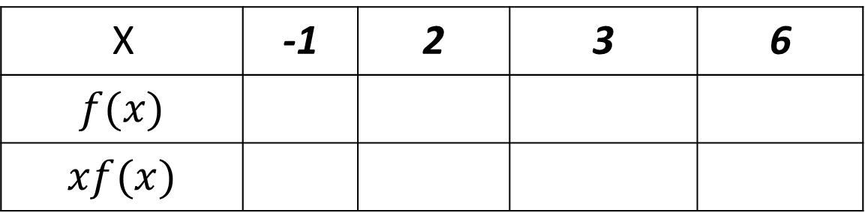

Example: variances of a discrete RV
Consider a RV $X$ with the following distribution. $Var\left(X\right)$=?
X | -1 | 2 | 3 | 6
$$f(x)$$
$$xf(x)$$
.25 .25 .15 .35
-.25 .50 .45 2.1
$$x−μ$$
$${\left(x−μ\right)}^{2}$$
$${f(x)\left(x−μ\right)}^{2}$$
-3.8 -.8 .2 3.2
14.44 0.64 .04 10.24
3.610 .16 .006 3.584

Slide 5
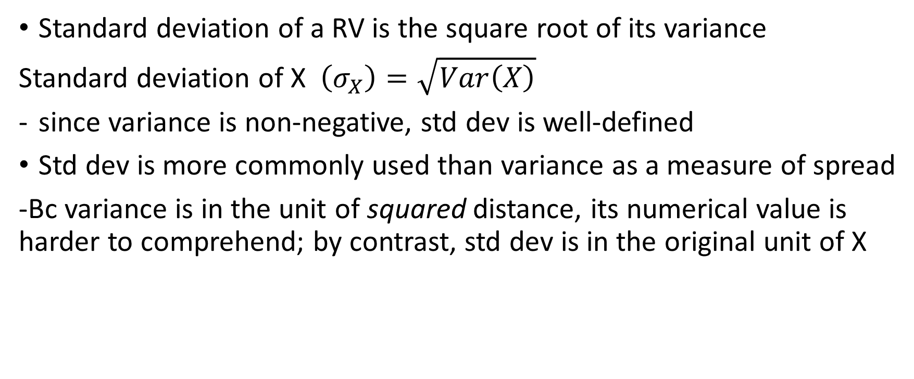
Standard deviations
Standard deviation of a RV is the square root of its variance
Standard deviation of X $\left(σ_{X}\right)=\sqrt{Var\left(X\right)}$
since variance is non-negative, std dev is well-defined
Std dev is more commonly used than variance as a measure of spread
-Bc variance is in the unit of squared distance, its numerical value is harder to comprehend; by contrast, std dev is in the original unit of X

Slide 6
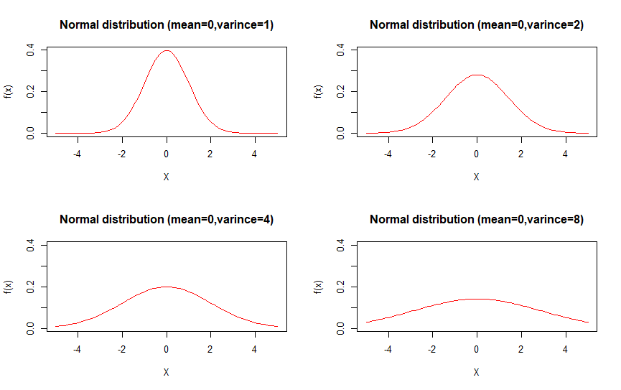

Slide 7

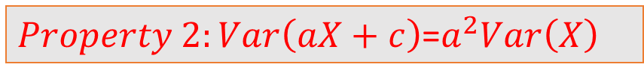

Properties: the expectation of a function of multiple RV’s
$$Property 1:Var\left(X\right)≥0$$
$Property 2:Var\left(aX+c\right)$=$a^{2}Var\left(X\right)$
$$Var\left(X\right)=E{[\left(X−μ\right)}^{2}]≥0$$
$Property 3:Var\left(X_{1}+X_{2}\right)=Var\left(X_{1}\right)+Var\left(X_{2}\right)$ if $X_{1}, X_{2}$ are independent

